Slide 1
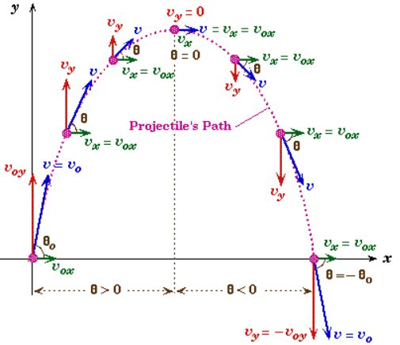
Projectile motion

Slide 2
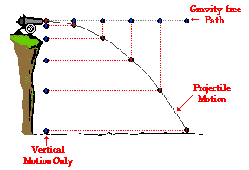
If an object is fired in a horizontal (x) direction, the x and y components both start and end at the same time. Therefore the “link” between the horizontal and vertical components is always freefall time. In the vertical (y) component, gravity is the acceleration. Gravity, however, does not pull in the horizontal direction, so the horizontal (x) component moves with an acceleration of zero or a constant velocity.
The time for all three paths shown is the same. The time it takes for the cannonball fired horizontally to hit the ground is the same as if a vertical only cannonball is dropped when horizontal ball is fired.

Slide 3
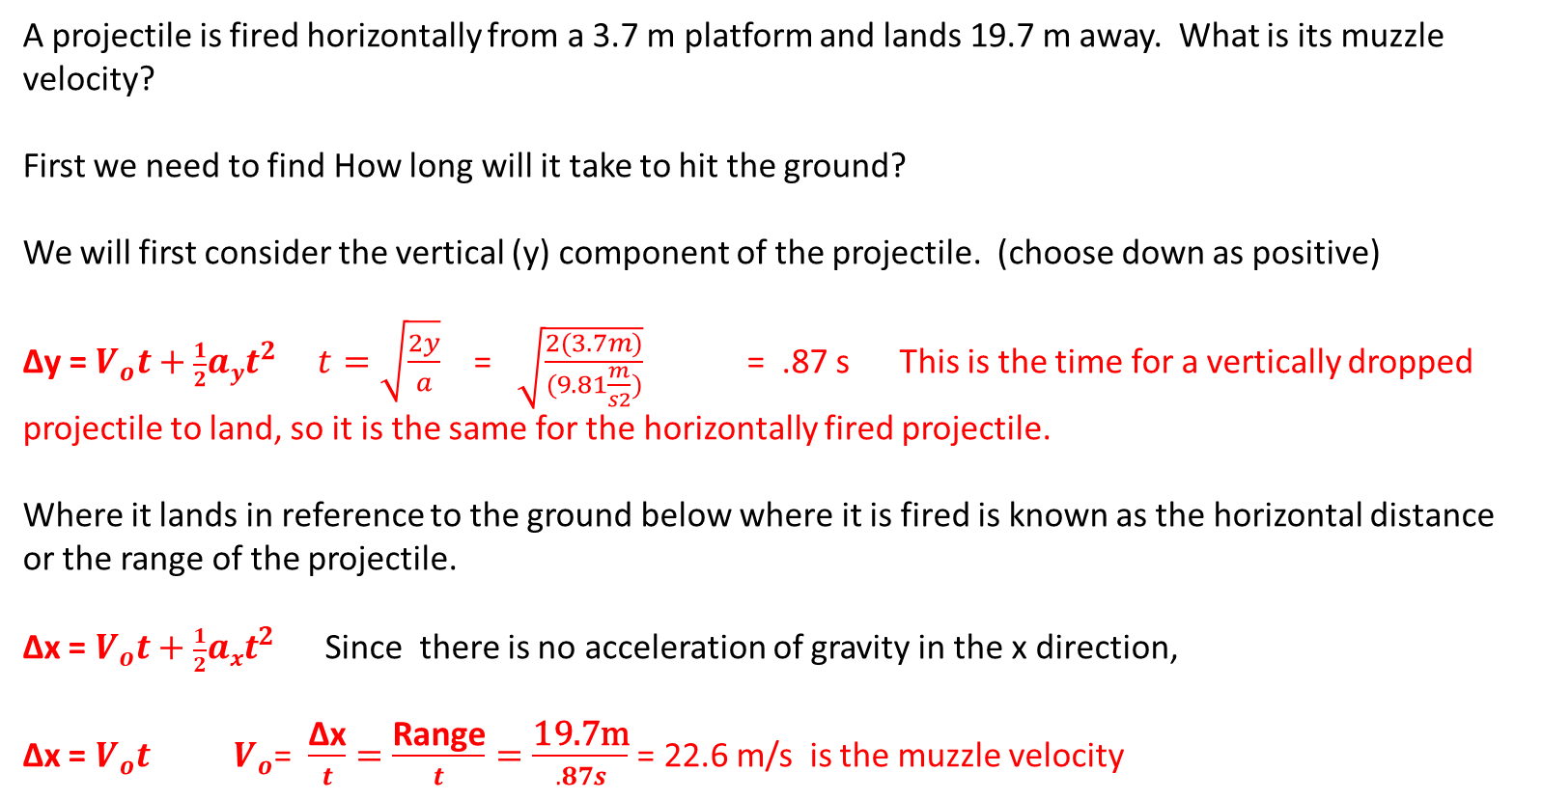
A projectile is fired horizontally from a 3.7 m platform and lands 19.7 m away. What is its muzzle velocity?
First we need to find How long will it take to hit the ground?
We will first consider the vertical (y) component of the projectile. (choose down as positive)
Δy = $V_{o}t+\frac{1}{2}ayt^{2}$ $t=\sqrt{\frac{2y}{a}}$ = $\sqrt{\frac{2(3.7m)}{(9.81\frac{m}{s2})}}$ = .87 s This is the time for a vertically dropped projectile to land, so it is the same for the horizontally fired projectile.
Where it lands in reference to the ground below where it is fired is known as the horizontal distance or the range of the projectile.
Δx = $V_{o}t+\frac{1}{2}axt^{2}$ Since there is no acceleration of gravity in the x direction,
Δx = $V_{o}t$ $V_{o}$= $\frac{\text{Δx}}{t}=\frac{\text{Range}}{t}=\frac{\text{19.7}\text{m}}{.87s}$ = 22.6 m/s is the muzzle velocity

Slide 4
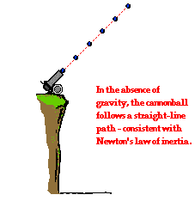
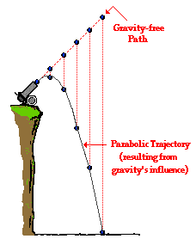
The y component is in vertical freefall with the acceleration of gravity
The x component, since there is no gravity force horizontally, moves with zero acceleration or at constant velocity.

Slide 5
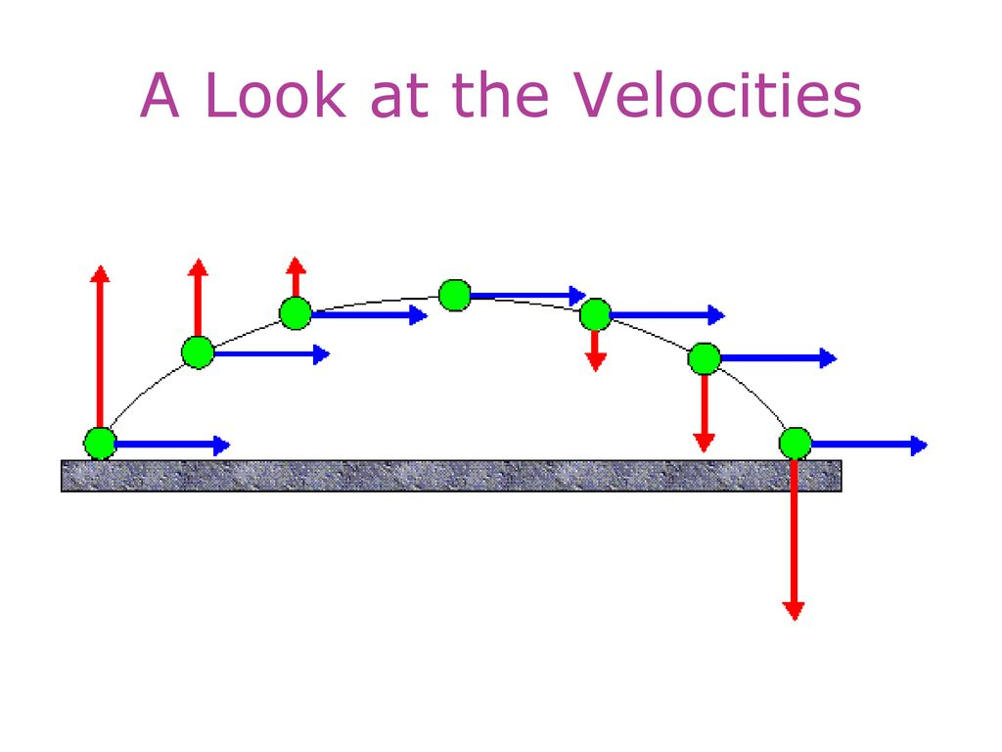

Slide 6
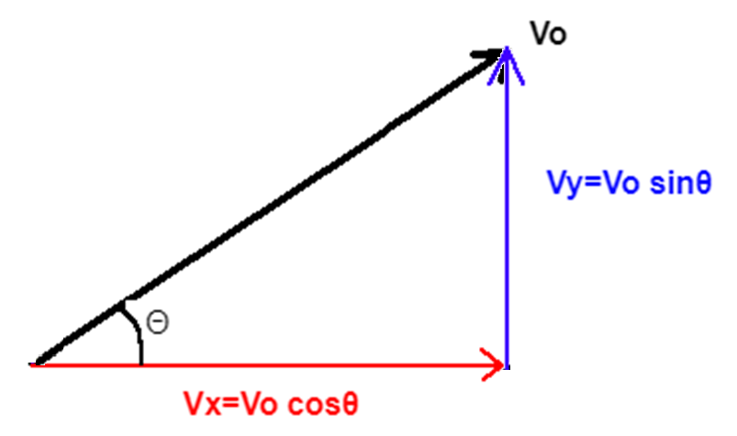
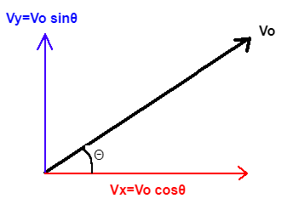
When there is a projectile fired at an angle, we have to consider the initial velocity having components in both the vertical(y) and the horizontal(x) directions. So the first step is to resolve the initial velocity into its x and y components.

Slide 7
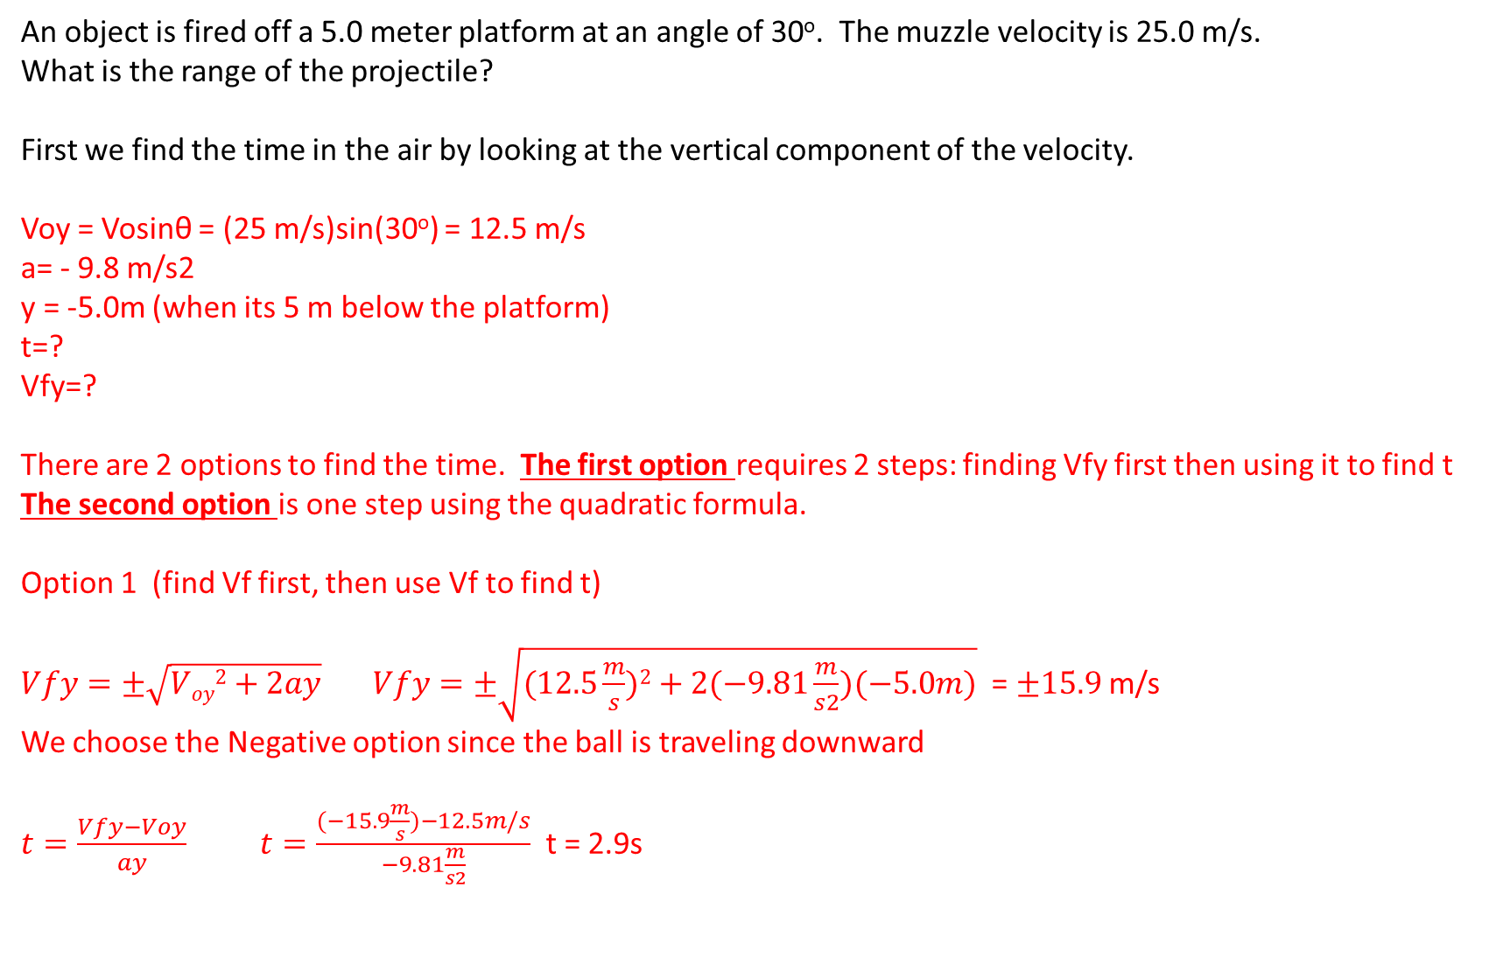
An object is fired off a 5.0 meter platform at an angle of 30º. The muzzle velocity is 25.0 m/s.
What is the range of the projectile?
First we find the time in the air by looking at the vertical component of the velocity.
Voy = Vosinθ = (25 m/s)sin(30º) = 12.5 m/s
a= - 9.8 m/s2
y = -5.0m (when its 5 m below the platform)
t=?
Vfy=?
There are 2 options to find the time. The first option requires 2 steps: finding Vfy first then using it to find t The second option is one step using the quadratic formula.
Option 1 (find Vf first, then use Vf to find t)
$Vfy=±\sqrt{Voy2+2ay} Vfy=±\sqrt{(12.5\frac{m}{s})2+2(−9.81\frac{m}{s2})(−5.0m)}$ = $±15.9$ m/s
We choose the Negative option since the ball is traveling downward
$t=\frac{Vfy−Voy}{ay}$ $t=\frac{(−15.9\frac{m}{s})−12.5m/s}{−9.81\frac{m}{s2}}$ t = 2.9s

Slide 8
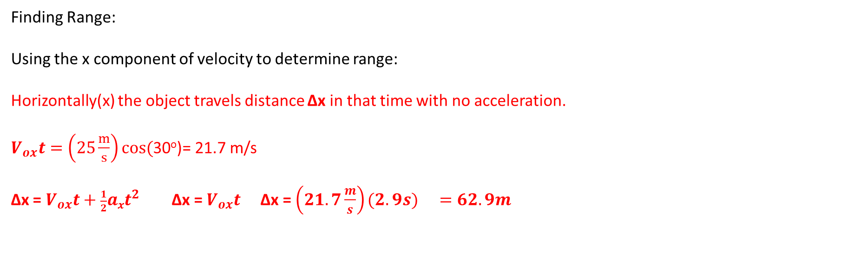
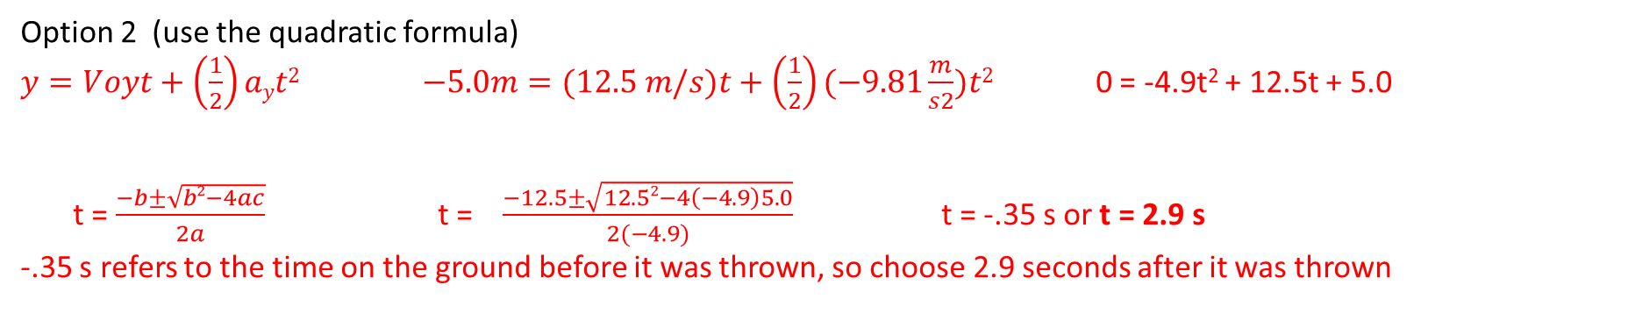
Option 2 (use the quadratic formula)
$y=Voyt+\left(\frac{1}{2}\right)ayt2$ $−5.0m=(12.5 m/s)t+\left(\frac{1}{2}\right)(−9.81\frac{m}{s2})t2$ 0 = -4.9t² + 12.5t + 5.0
t = $\frac{−b±\sqrt{b2−4ac}}{2a}$ t = $\frac{−12.5±\sqrt{12.52−4\left(−4.9\right)5.0}}{2(−4.9)}$ t = -.35 s or t = 2.9 s
-.35 s refers to the time on the ground before it was thrown, so choose 2.9 seconds after it was thrown
Finding Range:
Using the x component of velocity to determine range:
Horizontally(x) the object travels distance Δx in that time with no acceleration.
$V_{ox}t=\left(25\frac{m}{s}\right)cos($30º)= 21.7 m/s
Δx = $V_{ox}t+\frac{1}{2}axt^{2}$ Δx = $V_{ox}t$ Δx = ${\left(21.7\frac{m}{s}\right)(2.9s) }_{}=62.9m$

Slide 9
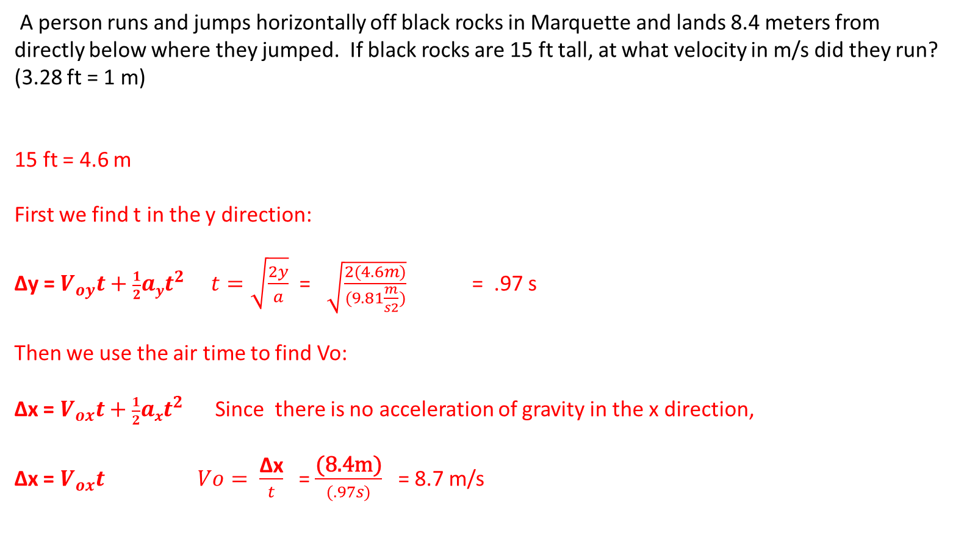
A person runs and jumps horizontally off black rocks in Marquette and lands 8.4 meters from directly below where they jumped. If black rocks are 15 ft tall, at what velocity in m/s did they run?
(3.28 ft = 1 m)
15 ft = 4.6 m
First we find t in the y direction:
Δy = $V_{oy}t+\frac{1}{2}ayt^{2}$ $t=\sqrt{\frac{2y}{a}}$ = $\sqrt{\frac{2(4.6m)}{(9.81\frac{m}{s2})}}$ = .97 s
Then we use the air time to find Vo:
Δx = $V_{ox}t+\frac{1}{2}axt^{2}$ Since there is no acceleration of gravity in the x direction,
Δx = $V_{ox}t$ $Vo= \frac{\text{Δx}}{t}$ = $\frac{\text{(8.4}\text{m}\text{)}}{(.97s)}$ = 8.7 m/s

Slide 10
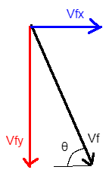
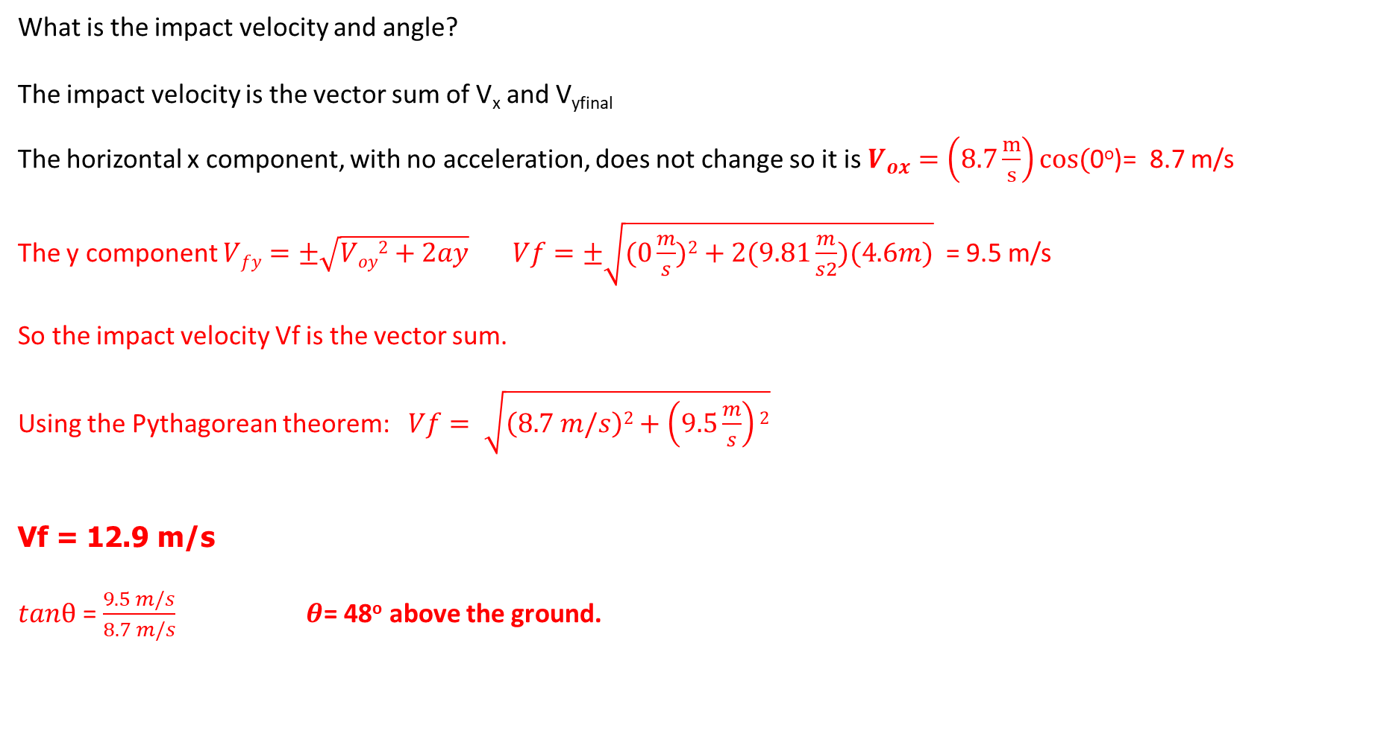
What is the impact velocity and angle?
The impact velocity is the vector sum of V_{x} and V_{yfinal}
The horizontal x component, with no acceleration, does not change so it is $V_{ox}=\left(8.7\frac{m}{s}\right)cos($0º)= 8.7 m/s
The y component $Vfy=±\sqrt{Voy2+2ay} Vf=±\sqrt{(0\frac{m}{s})2+2(9.81\frac{m}{s2})(4.6m)}$ = 9.5 m/s
So the impact velocity Vf is the vector sum.
Using the Pythagorean theorem: $Vf= \sqrt{\left(8.7 m/s\right)2+\left(9.5\frac{m}{s}\right)2}$
Vf = 12.9 m/s
$tanθ$ = $\frac{9.5 m/s}{8.7 m/s}$ $θ$= 48º above the ground.

Slide 11
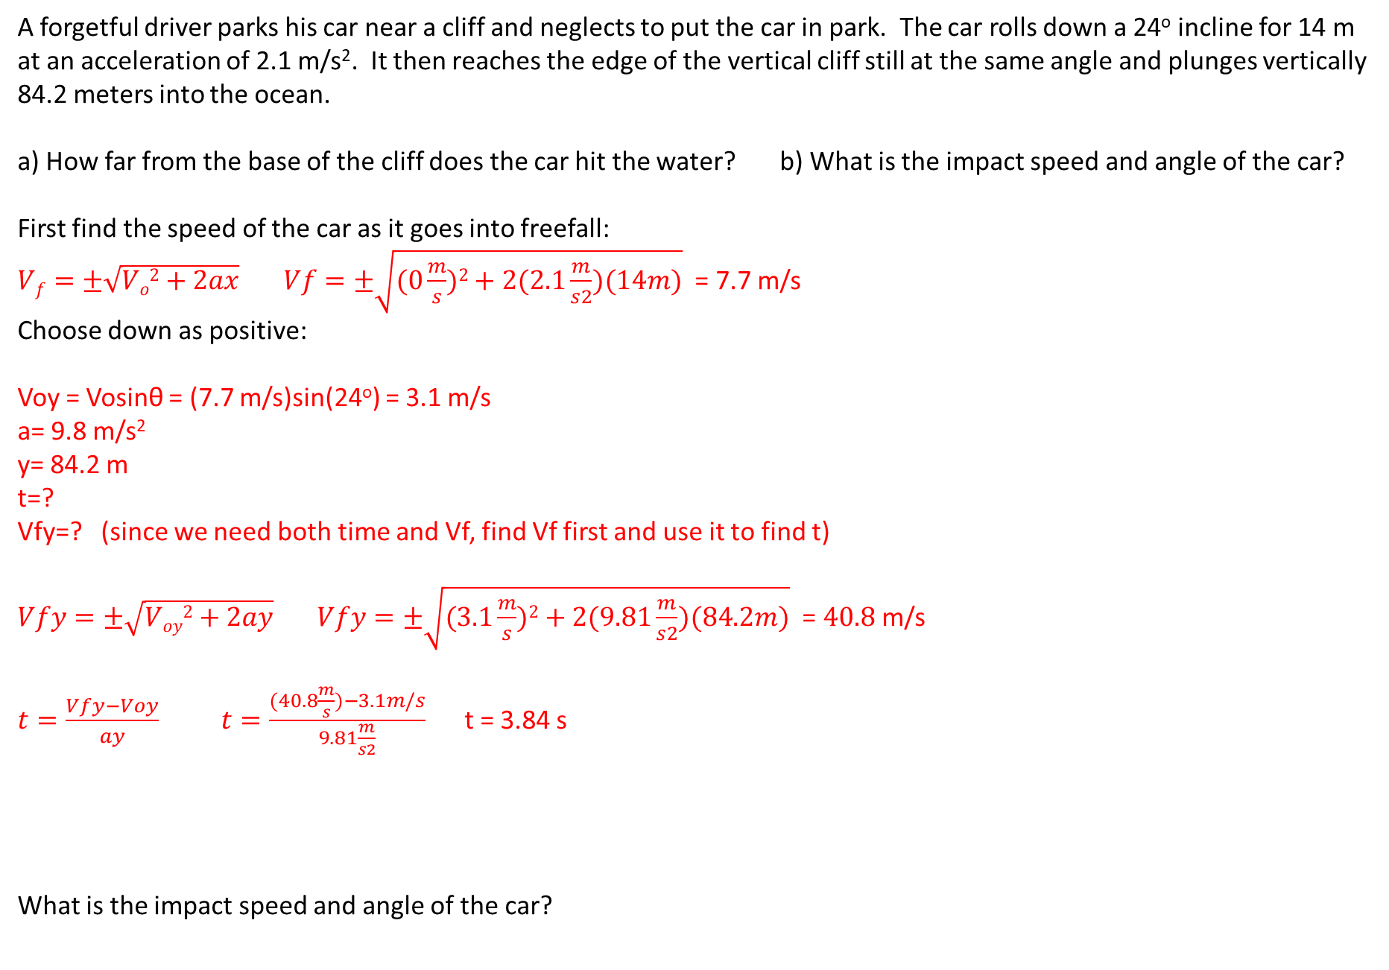
A forgetful driver parks his car near a cliff and neglects to put the car in park. The car rolls down a 24º incline for 14 m at an acceleration of 2.1 m/s². It then reaches the edge of the vertical cliff still at the same angle and plunges vertically 84.2 meters into the ocean.
a) How far from the base of the cliff does the car hit the water? b) What is the impact speed and angle of the car?
First find the speed of the car as it goes into freefall:
$Vf=±\sqrt{Vo2+2ax} Vf=±\sqrt{(0\frac{m}{s})2+2(2.1\frac{m}{s2})(14m)}$ = 7.7 m/s
Choose down as positive:
Voy = Vosinθ = (7.7 m/s)sin(24º) = 3.1 m/s
a= 9.8 m/s²
y= 84.2 m
t=?
Vfy=? (since we need both time and Vf, find Vf first and use it to find t)
$Vfy=±\sqrt{Voy2+2ay} Vfy=±\sqrt{(3.1\frac{m}{s})2+2(9.81\frac{m}{s2})(84.2m)}$ = $40.8$m/s
$t=\frac{Vfy−Voy}{ay}$ $t=\frac{(40.8\frac{m}{s})−3.1m/s}{9.81\frac{m}{s2}}$ t = 3.84 s
What is the impact speed and angle of the car?

Slide 12
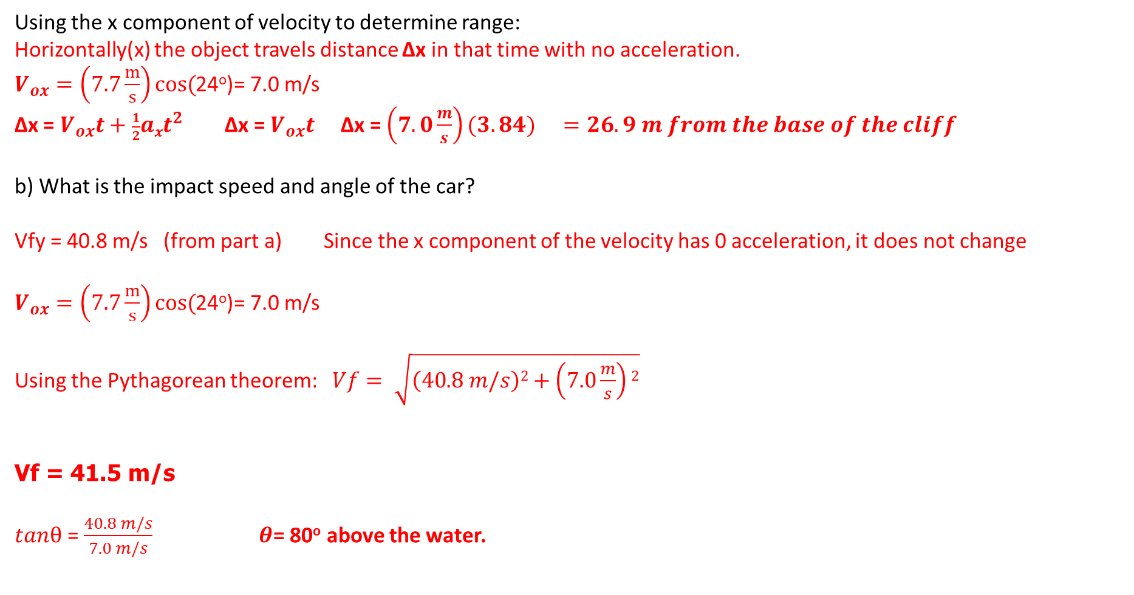
Using the x component of velocity to determine range:
Horizontally(x) the object travels distance Δx in that time with no acceleration.
$V_{ox}=\left(7.7\frac{m}{s}\right)cos($24º)= 7.0 m/s
Δx = $V_{ox}t+\frac{1}{2}axt^{2}$ Δx = $V_{ox}t$ Δx = ${\left(7.0\frac{m}{s}\right)(3.84) }_{}=26.9 m from the base of the cliff$
b) What is the impact speed and angle of the car?
Vfy = 40.8 m/s (from part a) Since the x component of the velocity has 0 acceleration, it does not change
$V_{ox}=\left(7.7\frac{m}{s}\right)cos($24º)= 7.0 m/s
Using the Pythagorean theorem: $Vf= \sqrt{\left(40.8 m/s\right)2+\left(7.0\frac{m}{s}\right)2}$
Vf = 41.5 m/s
$tanθ$ = $\frac{40.8 m/s}{7.0 m/s}$ $θ$= 80º above the water.

Slide 13
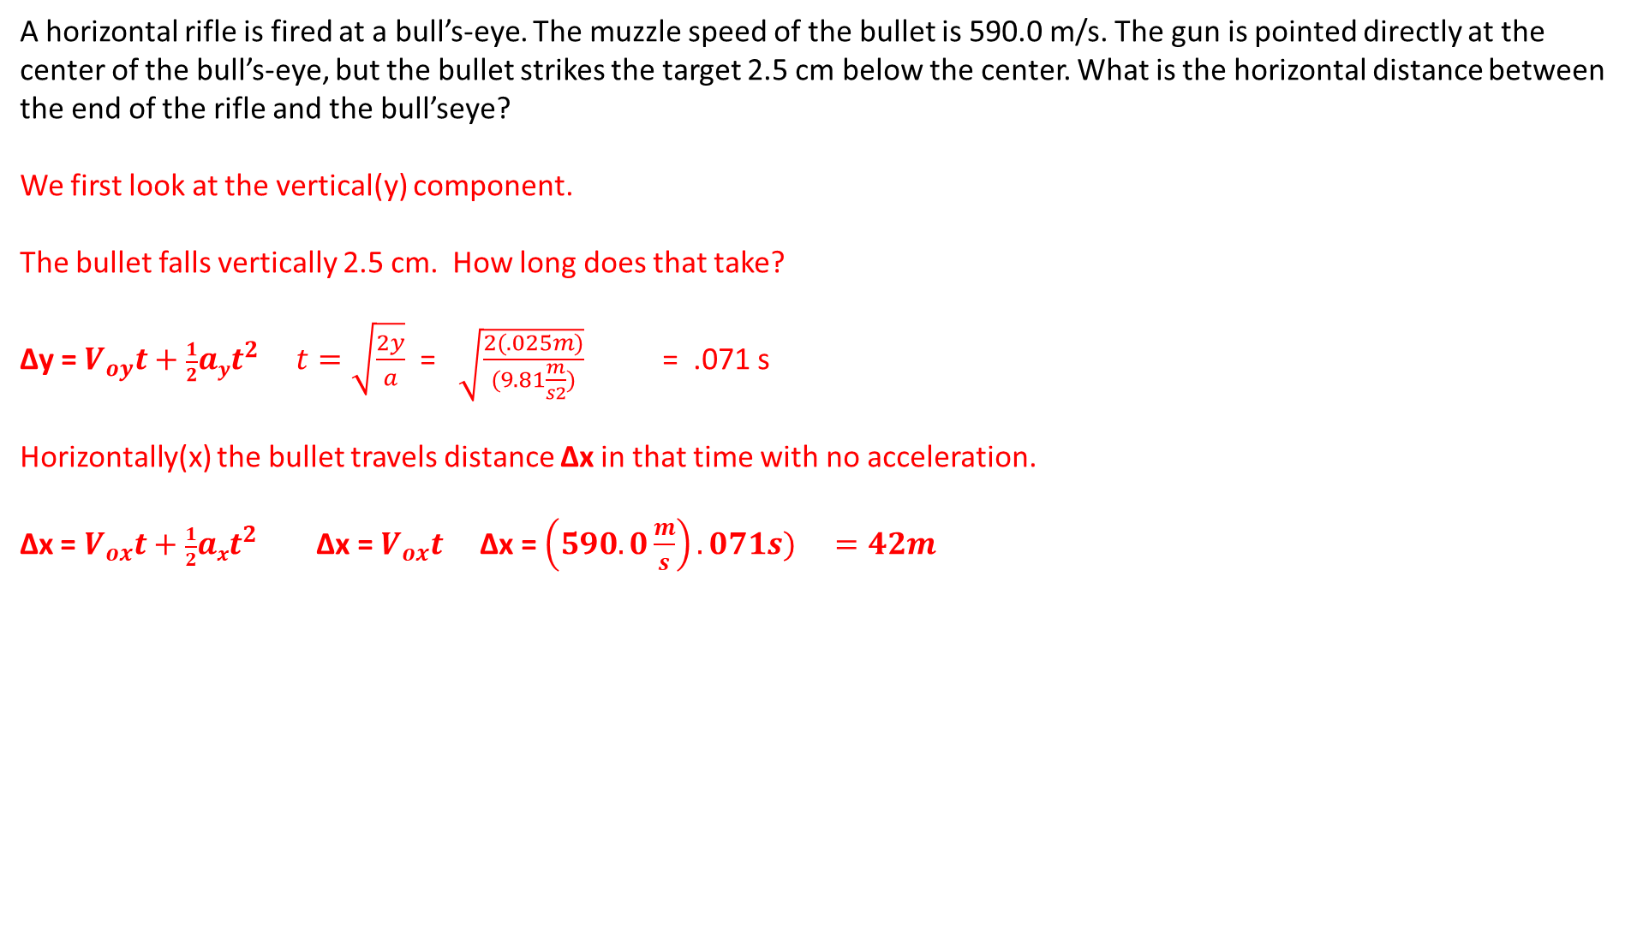
A horizontal rifle is fired at a bull’s-eye. The muzzle speed of the bullet is 590.0 m/s. The gun is pointed directly at the center of the bull’s-eye, but the bullet strikes the target 2.5 cm below the center. What is the horizontal distance between the end of the rifle and the bull’seye?
We first look at the vertical(y) component.
The bullet falls vertically 2.5 cm. How long does that take?
Δy = $V_{oy}t+\frac{1}{2}ayt^{2}$ $t=\sqrt{\frac{2y}{a}}$ = $\sqrt{\frac{2(.025m)}{(9.81\frac{m}{s2})}}$ = .071 s
Horizontally(x) the bullet travels distance Δx in that time with no acceleration.
Δx = $V_{ox}t+\frac{1}{2}axt^{2}$ Δx = $V_{ox}t$ Δx = ${\left(590.0\frac{m}{s}\right).071s) }_{}=42m$

Slide 14
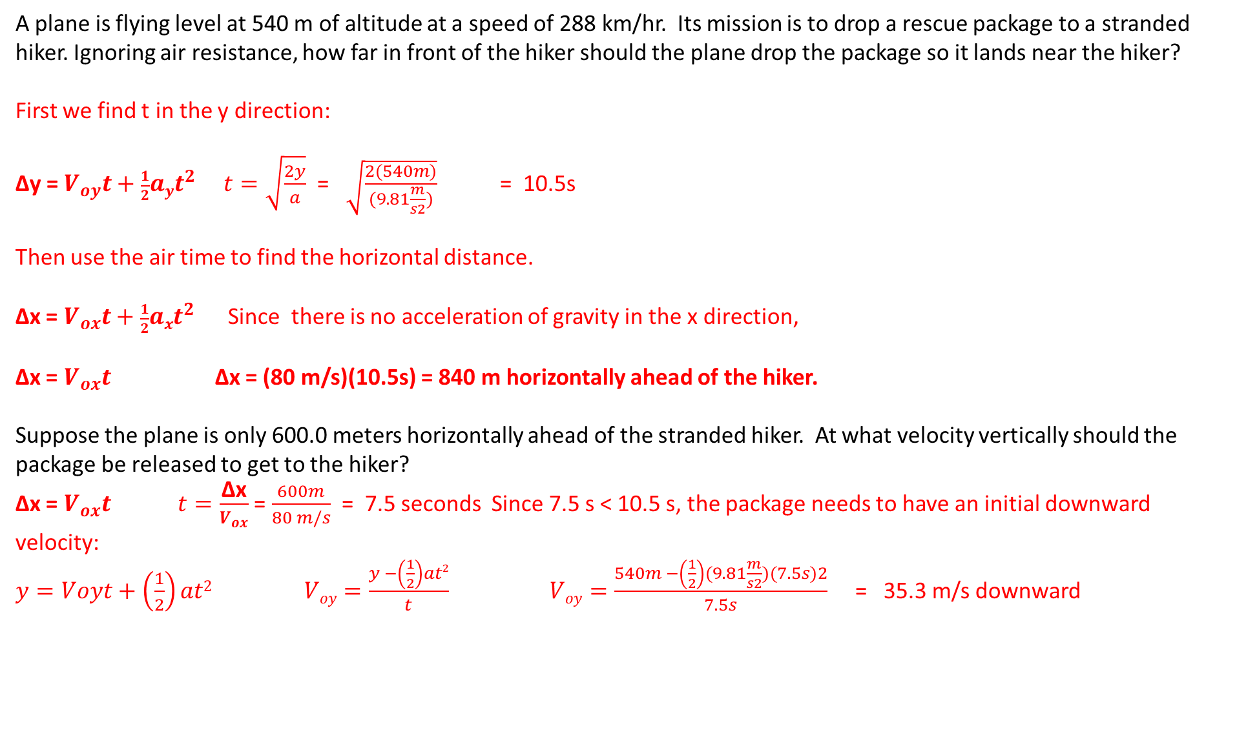
A plane is flying level at 540 m of altitude at a speed of 288 km/hr. Its mission is to drop a rescue package to a stranded hiker. Ignoring air resistance, how far in front of the hiker should the plane drop the package so it lands near the hiker?
First we find t in the y direction:
Δy = $V_{oy}t+\frac{1}{2}ayt^{2}$ $t=\sqrt{\frac{2y}{a}}$ = $\sqrt{\frac{2(540m)}{(9.81\frac{m}{s2})}}$ = 10.5s
Then use the air time to find the horizontal distance.
Δx = $V_{ox}t+\frac{1}{2}axt^{2}$ Since there is no acceleration of gravity in the x direction,
Δx = $V_{ox}t$ Δx = (80 m/s)(10.5s) = 840 m horizontally ahead of the hiker.
Suppose the plane is only 600.0 meters horizontally ahead of the stranded hiker. At what velocity vertically should the package be released to get to the hiker?
Δx = $V_{ox}t$ $t=\frac{\text{Δx}}{V_{ox}}$ = $\frac{600m}{80 m/s}$ = 7.5 seconds Since 7.5 s < 10.5 s, the package needs to have an initial downward velocity:
$y=Voyt+\left(\frac{1}{2}\right)at2 Voy=\frac{y −\left(\frac{1}{2}\right)at2}{t} Voy=\frac{540m −\left(\frac{1}{2}\right)(9.81\frac{m}{s2})(7.5s)2}{7.5s}$ = 35.3 m/s downward

Slide 15
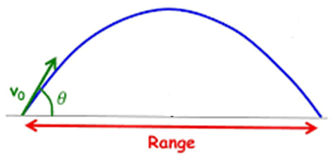
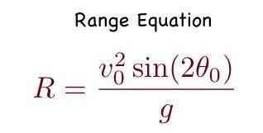
The Range Equation: A handy tool for a special case.
**Be careful not to use it in the wrong situation!!**
The range equation only works for projectile motion that starts and ends at the same vertical displacement. Only for a level to level projectile flight. It will not give a correct range if the projectile lands at a different height than it started at.
The range equation does not use the components of the velocity but instead the starting velocity at the angle.

Slide 16
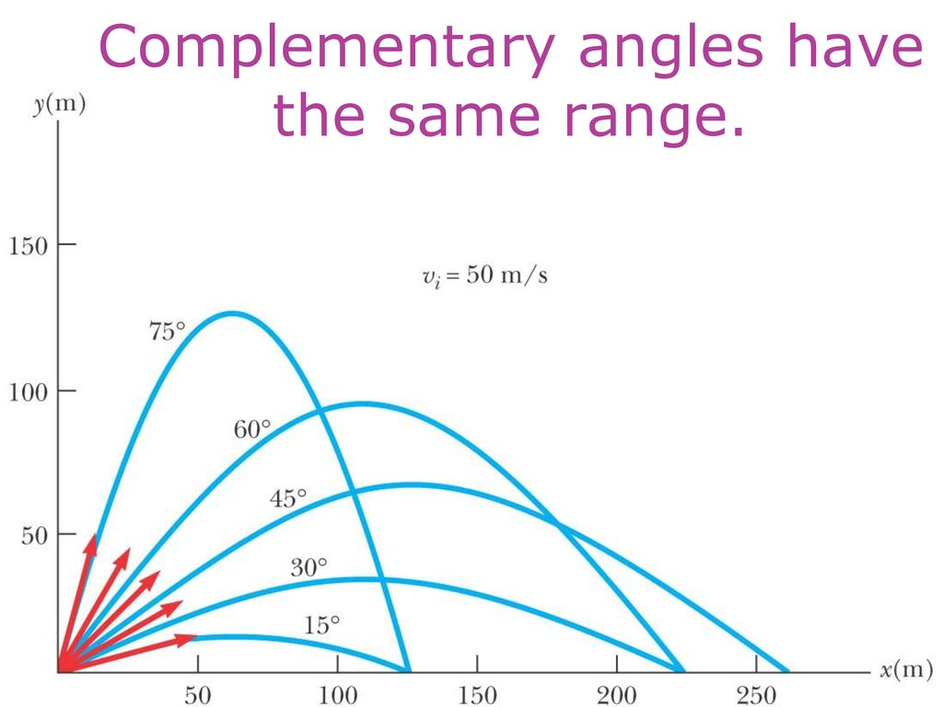
The maximum range for a projectile occurs at 45º. For ranges shorter than the maximum there are 2 angles that will have equal ranges. Those angles are the same number of degrees above or below 45º
Example: 45º + 15º = 60º 45º – 15º = 30º Since 60º is 15º above 45º and 30º is 15º below 45º , 60º and 30º will have the same range.
Since 30º + 60º add to 90º, another way to look at it is that complementary angles have the same range.

Slide 17
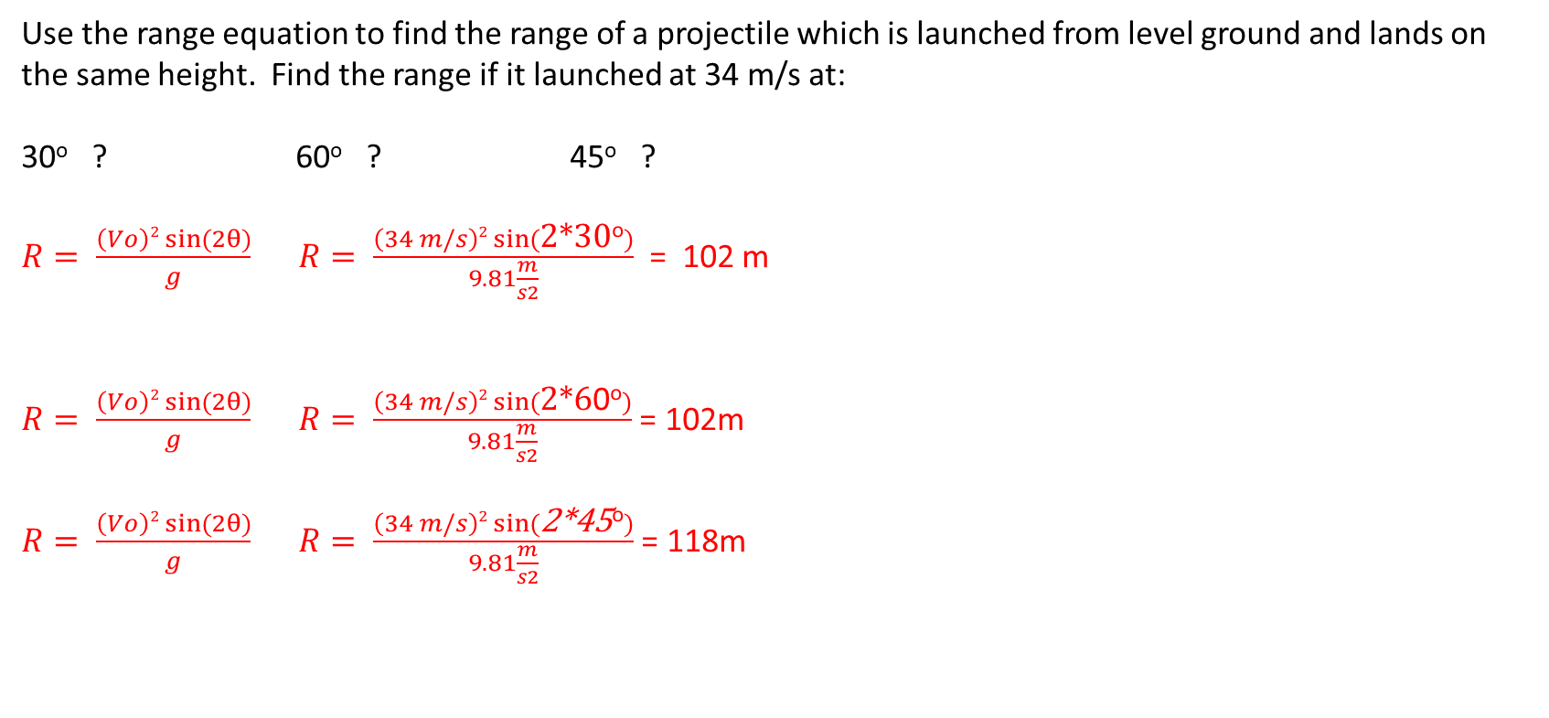
Use the range equation to find the range of a projectile which is launched from level ground and lands on the same height. Find the range if it launched at 34 m/s at:
30º ? 60º ? 45º ?
$R= \frac{\left(Vo\right)2 sin⁡(2θ)}{g}$ $R= \frac{\left(34 m/s\right)2 sin⁡(\text{2*30}\text{o})}{9.81\frac{m}{s2}}$ = 102 m
$R= \frac{\left(Vo\right)2 sin⁡(2θ)}{g}$ $R= \frac{\left(34 m/s\right)2 sin⁡(\text{2*6}\text{0}\text{o})}{9.81\frac{m}{s2}}$ = 102m
$R= \frac{\left(Vo\right)2 sin⁡(2θ)}{g}$ $R= \frac{\left(34 m/s\right)2 sin⁡(\text{2*45}\text{o})}{9.81\frac{m}{s2}}$ = 118m

Slide 18
Which angle is better?
Higher angle: Longer air time. Approaches target at a steeper angle
Lower angle: Shorter air time. Approaches target at a lower angle.
Each can be an advantage in different situations
In some sports the higher angle is often chosen:
Basket ball: Shoot over a defender and the basket is a larger target from a steeper angle.
Golf: Approach the green at a high angle so the ball stays closer to where it lands.
However, a lower angle may be better in some circumstances:
On a golf drive on a windy day a lower angle may be chosen to avoid airtime in the wind and landing at a lower angle may allow the ball to run.
In archery or competitive shooting, a lower angle is chosen to help with aim and avoid the extra air time in wind. You would choose a 5 degree elevation angle of aim over an 85 degree angle!
In some sports its either depending on the strategy:
In football a lower pass gets to the receiver quicker but may be harder to catch while a higher pass can be dropped in over defenders, so it depends on the defensive coverage. For a “Hail Mary” pass for maximum distance choose 45 degrees!
Tennis: most shots are at a low angle but a “lob shot” is often the best choice!

Slide 19
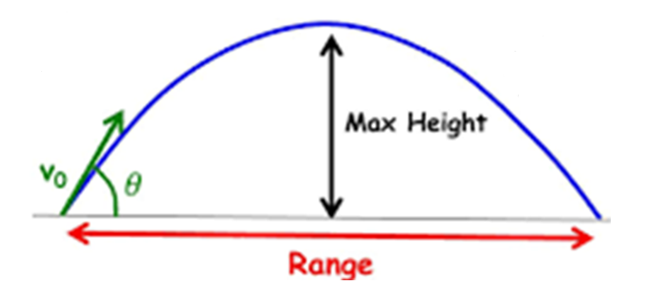
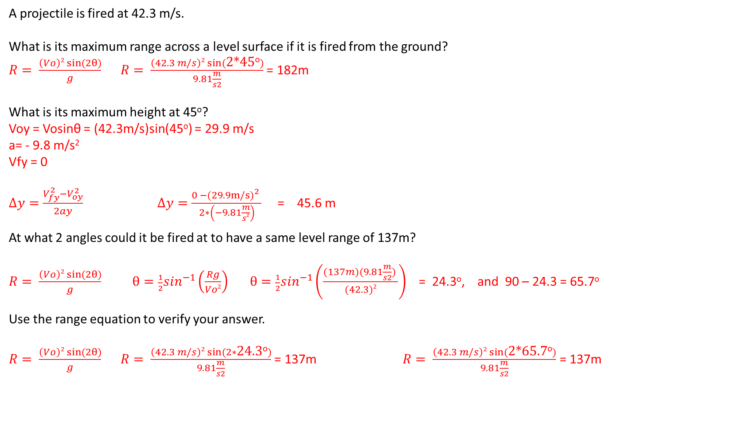
A projectile is fired at 42.3 m/s.
What is its maximum range across a level surface if it is fired from the ground?
$R= \frac{\left(Vo\right)2 sin⁡(2θ)}{g}$ $R= \frac{\left(42.3 m/s\right)2 sin⁡(\text{2∗45}\text{o})}{9.81\frac{m}{s2}}$ = 182m
What is its maximum height at 45º?
Voy = Vosinθ = (42.3m/s)sin(45º) = 29.9 m/s
a= - 9.8 m/s²
Vfy = 0
$Δy=\frac{V_{fy}^{2}−V_{oy}^{2}}{2ay}$ $Δy=\frac{0 −{(29.9m/s)}_{}^{2}}{\begin{aligned}2∗\left(−9.81\frac{m}{s2}\right) \\ \end{aligned}}$ = 45.6 m
At what 2 angles could it be fired at to have a same level range of 137m?
$R= \frac{\left(Vo\right)2 sin⁡(2θ)}{g}$ $θ=\frac{1}{2}\sin^{−1}\left(\frac{Rg}{Vo2}\right)$ $θ=\frac{1}{2}\sin^{−1}\left(\frac{(137m)(9.81\frac{m}{s2}) }{(42.3)2}\right)$ = 24.3º, and 90 – 24.3 = 65.7º
Use the range equation to verify your answer.
$R= \frac{\left(Vo\right)2 sin⁡(2θ)}{g}$ $R= \frac{\left(42.3 m/s\right)2 sin⁡(2∗\text{24.3}\text{o})}{9.81\frac{m}{s2}}$ = 137m $R= \frac{\left(42.3 m/s\right)2 sin⁡(\text{2∗65.7}\text{o})}{9.81\frac{m}{s2}}$ = 137m

Slide 20

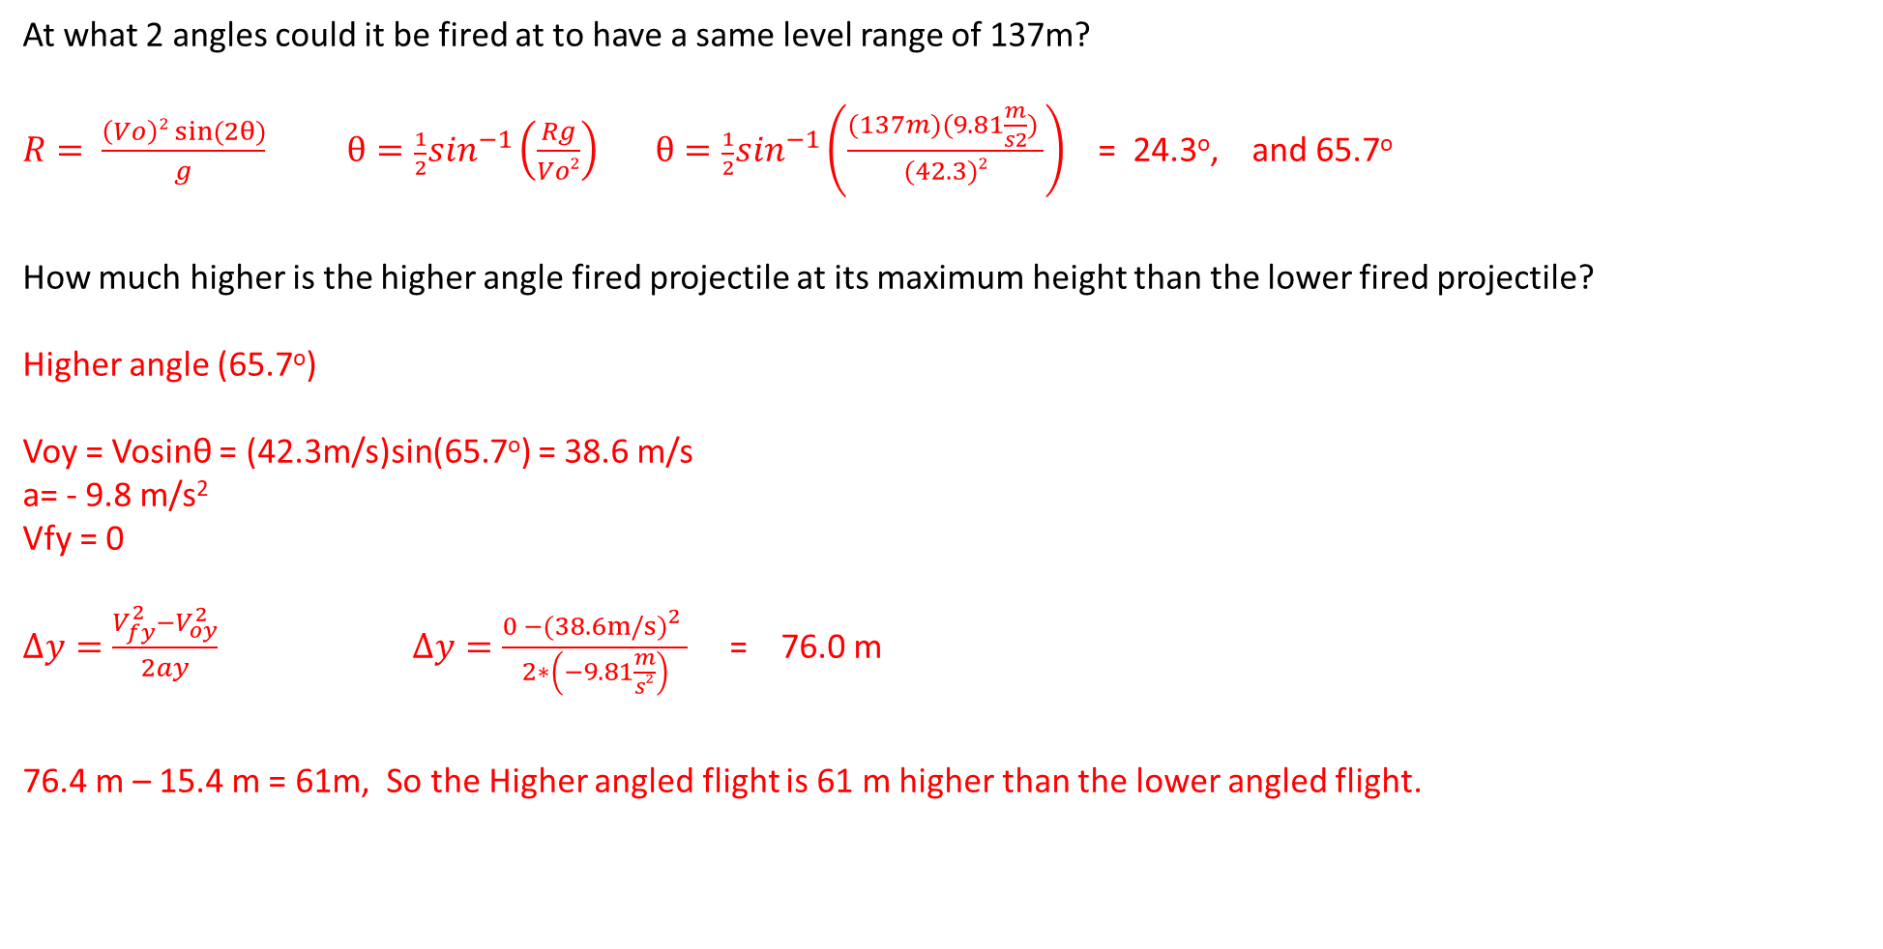
At what 2 angles could it be fired at to have a same level range of 137m?
$R= \frac{\left(Vo\right)2 sin⁡(2θ)}{g}$ $θ=\frac{1}{2}\sin^{−1}\left(\frac{Rg}{Vo2}\right)$ $θ=\frac{1}{2}\sin^{−1}\left(\frac{(137m)(9.81\frac{m}{s2}) }{(42.3)2}\right)$ = 24.3º, and 65.7º
How much higher is the higher angle fired projectile at its maximum height than the lower fired projectile?
Higher angle (65.7º)
Voy = Vosinθ = (42.3m/s)sin(65.7º) = 38.6 m/s
a= - 9.8 m/s²
Vfy = 0
$Δy=\frac{V_{fy}^{2}−V_{oy}^{2}}{2ay}$ $Δy=\frac{0 −{(38.6m/s)}_{}^{2}}{\begin{aligned}2∗\left(−9.81\frac{m}{s2}\right) \\ \end{aligned}}$ = 76.0 m
76.4 m – 15.4 m = 61m, So the Higher angled flight is 61 m higher than the lower angled flight.
Lower angle (24.3º)
Voy = Vosinθ = (42.3m/s)sin(24.3º) = 17.4 m/s
a= - 9.8 m/s²
Vfy = 0
$Δy=\frac{V_{fy}^{2}−V_{oy}^{2}}{2ay}$ $Δy=\frac{0 −{(17.4m/s)}_{}^{2}}{\begin{aligned}2∗\left(−9.81\frac{m}{s2}\right) \\ \end{aligned}}$ = 15.4 m

Slide 21
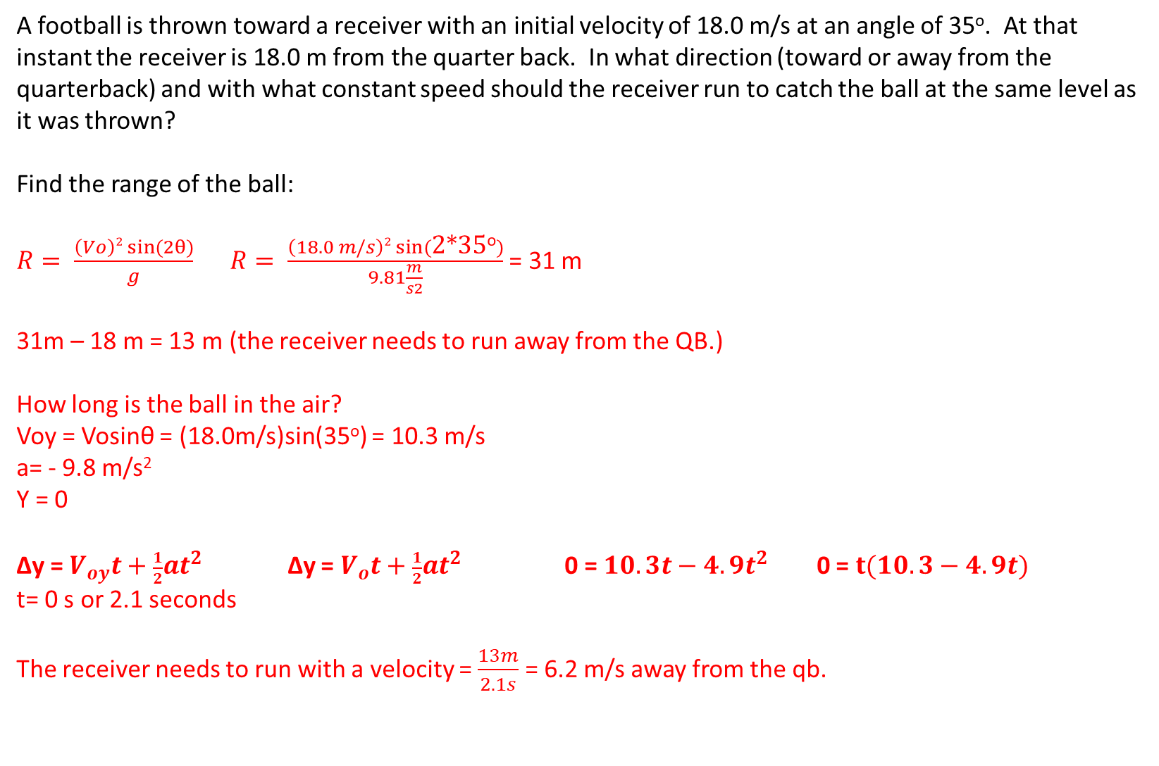
A football is thrown toward a receiver with an initial velocity of 18.0 m/s at an angle of 35º. At that instant the receiver is 18.0 m from the quarter back. In what direction (toward or away from the quarterback) and with what constant speed should the receiver run to catch the ball at the same level as it was thrown?
Find the range of the ball:
$R= \frac{\left(Vo\right)2 sin⁡(2θ)}{g}$ $R= \frac{\left(18.0 m/s\right)2 sin⁡(\text{2*35}\text{o})}{9.81\frac{m}{s2}}$ = 31 m
31m – 18 m = 13 m (the receiver needs to run away from the QB.)
How long is the ball in the air?
Voy = Vosinθ = (18.0m/s)sin(35º) = 10.3 m/s
a= - 9.8 m/s²
Y = 0
Δy = $V_{oy}t+\frac{1}{2}at^{2}$ Δy = $V_{o}t+\frac{1}{2}at^{2}$ 0 = $10.3t−4.9t^{2}$ 0 = $t(10.3−4.9{t)}^{}$
t= 0 s or 2.1 seconds
The receiver needs to run with a velocity = $\frac{13m}{2.1s}$ = 6.2 m/s away from the qb.

Slide 22
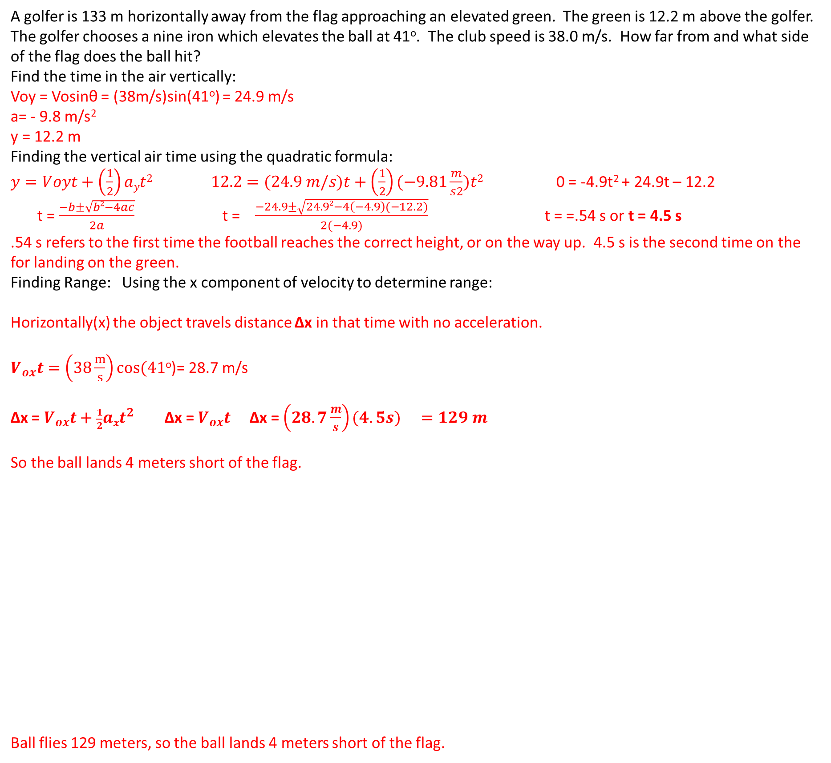
A golfer is 133 m horizontally away from the flag approaching an elevated green. The green is 12.2 m above the golfer. The golfer chooses a nine iron which elevates the ball at 41º. The club speed is 38.0 m/s. How far from and what side of the flag does the ball hit?
Find the time in the air vertically:
Voy = Vosinθ = (38m/s)sin(41º) = 24.9 m/s
a= - 9.8 m/s²
y = 12.2 m
Finding the vertical air time using the quadratic formula:
$y=Voyt+\left(\frac{1}{2}\right)ayt2$ $12.2=(24.9 m/s)t+\left(\frac{1}{2}\right)(−9.81\frac{m}{s2})t2$ 0 = -4.9t² + 24.9t – 12.2
t = $\frac{−b±\sqrt{b2−4ac}}{2a}$ t = $\frac{−24.9±\sqrt{24.92−4\left(−4.9\right)(−12.2)}}{2(−4.9)}$ t = =.54 s or t = 4.5 s
.54 s refers to the first time the football reaches the correct height, or on the way up. 4.5 s is the second time on the for landing on the green.
Finding Range: Using the x component of velocity to determine range:
Horizontally(x) the object travels distance Δx in that time with no acceleration.
$V_{ox}t=\left(38\frac{m}{s}\right)cos(41$º)= 28.7 m/s
Δx = $V_{ox}t+\frac{1}{2}axt^{2}$ Δx = $V_{ox}t$ Δx = ${\left(28.7\frac{m}{s}\right)(4.5s) }_{}=129 m$
So the ball lands 4 meters short of the flag.
Ball flies 129 meters, so the ball lands 4 meters short of the flag.

Slide 23
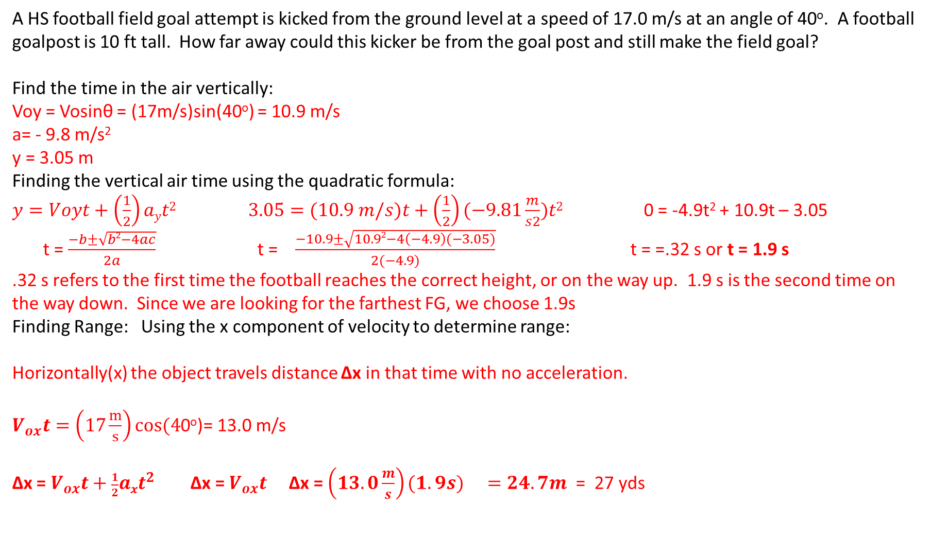
A HS football field goal attempt is kicked from the ground level at a speed of 17.0 m/s at an angle of 40º. A football goalpost is 10 ft tall. How far away could this kicker be from the goal post and still make the field goal?
Find the time in the air vertically:
Voy = Vosinθ = (17m/s)sin(40º) = 10.9 m/s
a= - 9.8 m/s²
y = 3.05 m
Finding the vertical air time using the quadratic formula:
$y=Voyt+\left(\frac{1}{2}\right)ayt2$ $3.05=(10.9 m/s)t+\left(\frac{1}{2}\right)(−9.81\frac{m}{s2})t2$ 0 = -4.9t² + 10.9t – 3.05
t = $\frac{−b±\sqrt{b2−4ac}}{2a}$ t = $\frac{−10.9±\sqrt{10.92−4\left(−4.9\right)(−3.05)}}{2(−4.9)}$ t = =.32 s or t = 1.9 s
.32 s refers to the first time the football reaches the correct height, or on the way up. 1.9 s is the second time on the way down. Since we are looking for the farthest FG, we choose 1.9s
Finding Range: Using the x component of velocity to determine range:
Horizontally(x) the object travels distance Δx in that time with no acceleration.
$V_{ox}t=\left(17\frac{m}{s}\right)cos(4$0º)= 13.0 m/s
Δx = $V_{ox}t+\frac{1}{2}axt^{2}$ Δx = $V_{ox}t$ Δx = ${\left(13.0\frac{m}{s}\right)(1.9s) }_{}=24.7m$ = 27 yds

Slide 24
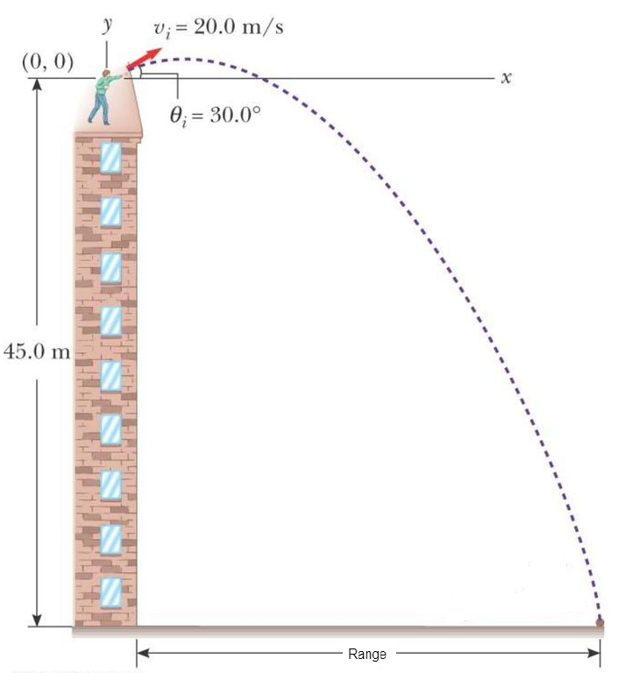
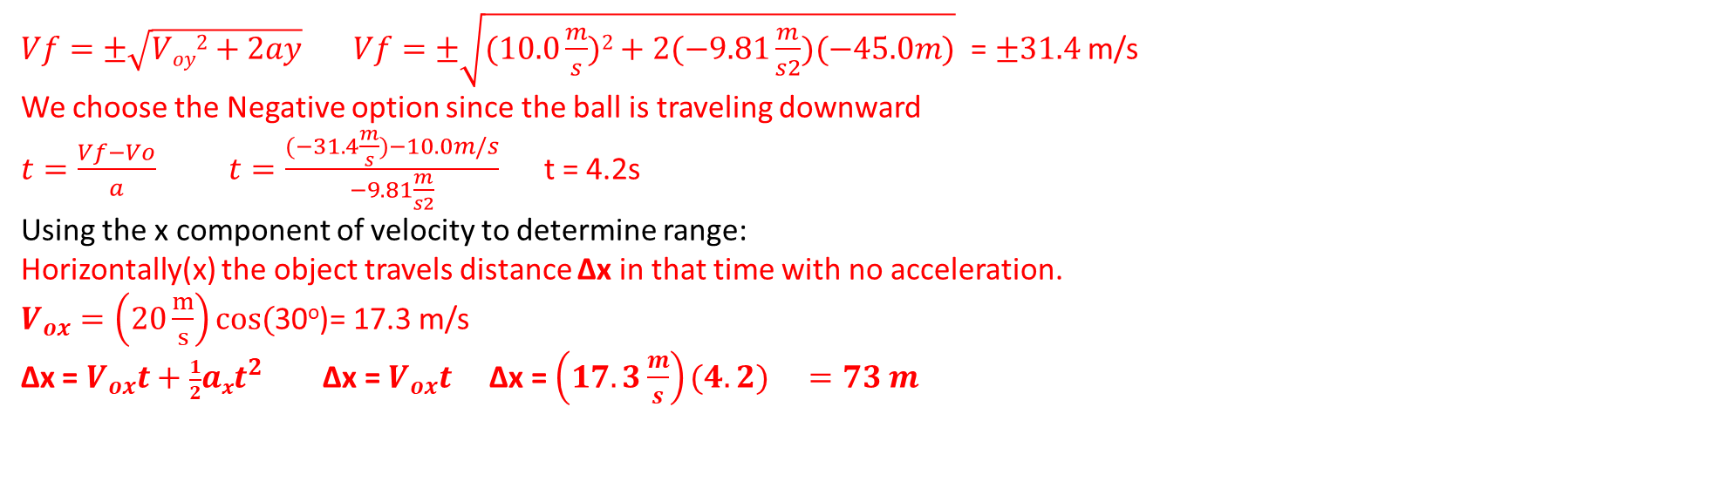
A projectile is launched from a 45.0 m height at 30º with a velocity of 20.0 m/s
What is the range of the projectile?
What is the impact velocity of the projectile?
At what angle θ from the horizontal does the projectile impact?
Voy = Vosinθ = (20 m/s)sin(30º) = 10.0 m/s
a= - 9.8 m/s²
y = -45.0m (when it’s 45 m below the platform)
t=?
Vfy=? (since we need both time and Vf, find Vf first and use it to find t)
$Vf=±\sqrt{Voy2+2ay} Vf=±\sqrt{(10.0\frac{m}{s})2+2(−9.81\frac{m}{s2})(−45.0m)}$ = $±31.4$ m/s
We choose the Negative option since the ball is traveling downward
$t=\frac{Vf−Vo}{a}$ $t=\frac{(−31.4\frac{m}{s})−10.0m/s}{−9.81\frac{m}{s2}}$ t = 4.2s
Using the x component of velocity to determine range:
Horizontally(x) the object travels distance Δx in that time with no acceleration.
$V_{ox}=\left(20\frac{m}{s}\right)cos($30º)= 17.3 m/s
Δx = $V_{ox}t+\frac{1}{2}axt^{2}$ Δx = $V_{ox}t$ Δx = ${\left(17.3\frac{m}{s}\right)(4.2) }_{}=73 m$

Slide 25
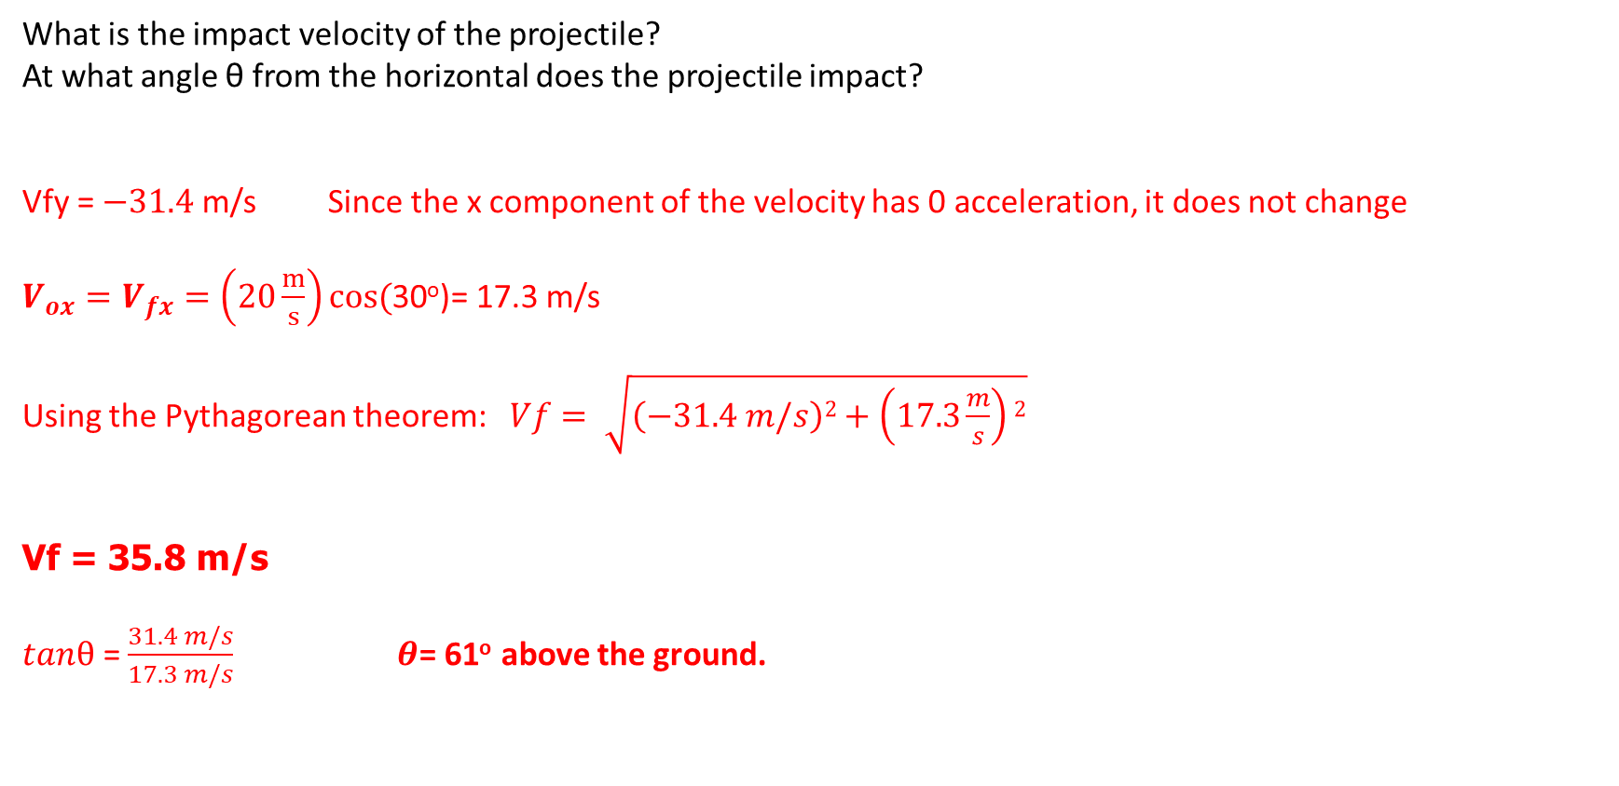
What is the impact velocity of the projectile?
At what angle θ from the horizontal does the projectile impact?
Vfy = $−31.4$ m/s Since the x component of the velocity has 0 acceleration, it does not change
$V_{ox}=V_{fx}=\left(20\frac{m}{s}\right)cos($30º)= 17.3 m/s
Using the Pythagorean theorem: $Vf= \sqrt{\left(−31.4 m/s\right)2+\left(17.3\frac{m}{s}\right)2}$
Vf = 35.8 m/s
$tanθ$ = $\frac{31.4 m/s}{17.3 m/s}$ $θ$= 61º above the ground.

